Slide 1

Pharmacy Management & Medicine Checker
Prepared by: (The Web Warriors)
Fady Emad (Team Leader)
Mariam Gamal
Gannah Islam
Zeinab Ahmed
Mohraeel John
Mohamed Yasser
Poula Samy
Mina Montasser
Dr: Wesam Ahmed

Slide 2
***Important Note.***
All Documents and Details about the project will be On GitHub. Feel Free to check it at anytime By clicking the following link:
Pharmacy-Management-Project/Pharmacy Management Project at main · FadyEmad12/Pharmacy-Management-Project

Slide 3
Content:
Project Title.
Problem Statement / Motivation
Project Goals / Objectives
Tools and Technologies Used
Features / Functionality
Development Process / Story
Project Outcome / Results
Future Enhancements

Slide 4
Project Title and Problem Statement / Motivation
Project Title: Pharmacy Management & Medicine Checker System.
Problem Statement / Motivation: Managing a pharmacy manually is time-consuming and error-prone. Pharmacists often face challenges such as:
Tracking medicine stock
Handling customer prescriptions efficiently
Recording sales and profits
Downloading the Invoices of the sold items per day.
Our project solves these issues by automating pharmacy operations, improving accuracy, saving time, and ensuring better customer service.

Slide 5
Project Goals / Objectives
The main objectives of the Pharmacy Management System are:
To provide accurate tracking of medicines in stock
To record and manage sales efficiently
To generate reports on profits, sales, and inventory
To make it very easy for the customers to check the Medicines instead of Going to the Pharmacy.
To minimize human errors in pharmacy operations
To Prepare the invoices for the items are sold at anytime.

Slide 6
Tools and Technologies Used
1- Programming Languages & Frameworks
C# – Main programming language for backend logic
.NET Core – Framework for building scalable and secure backend applications
ASP.NET Web API – To create RESTful APIs for handling database operations and communication between frontend and backend.

Slide 7
2- Database System
SQL Server – Relational database to store medicine data, sales records, and other pharmacy-related information
Entity Framework (Database-First approach) – Object-relational mapper (ORM) for easier database interaction using C# classes
3- Frontend / Client-Side
HTML5 – Structuring web pages
CSS – Styling the application
JavaScript – Adding interactivity and dynamic behavior to the frontend

Slide 8
4- Additional Tools & Technologies
Node.js – For running frontend build tools or server-side scripts if needed
Visual Studio / VS Code – IDEs for coding, and debugging.
Trello – For Project Management
Whatsapp & GitHub – Version control and project collaboration platform

Slide 9
Features / Functionality
1- Medicine Management:
Add, update, delete medicine records
Track stock quantity
2- Customer Interaction:
Customers can search for medicines by name or type
No customer data is stored or payments are taken

Slide 10
3- Sales and Billing:
Record all sales by the pharmacist
Print invoices after recording sales
Automatically update inventory
4- Reports and Analytics:
Generate sales reports
Track profit and loss
5- User Authentication:
Login system for pharmacists and admins
Role-based access to ensure security

Slide 11
Development Process / Story
1- Planning: ➔ Was Made on Trello and GanttProject. The project started by carefully analyzing the needs of a typical pharmacy. We identified the key tasks that needed automation, including:
Managing medicine stock efficiently
Recording sales accurately
Allowing customers to search for medicines easily
Generating detailed sales and profit reports We also outlined the roles of users in the system — pharmacists as admins who manage the data, and customers who can search for medicines. This phase included sketching initial workflows and creating a requirements document to guide development.

Slide 12
2- Design: Once the requirements were clear, we moved to designing the system:
Created a relational database schema to store medicines, stock quantities, and sales records efficiently. Tables were designed with proper relationships and constraints to maintain data integrity.
Developed a user-friendly interface design that is simple for pharmacists to navigate and easy for customers to search for medicines.
Designed forms for adding/updating medicines and modules for recording sales.
Planned the invoice printing module to generate professional receipts automatically after each recorded sale.
Drew flowcharts and diagrams to visualize how each module interacts with others, ensuring smooth integration.

Slide 13
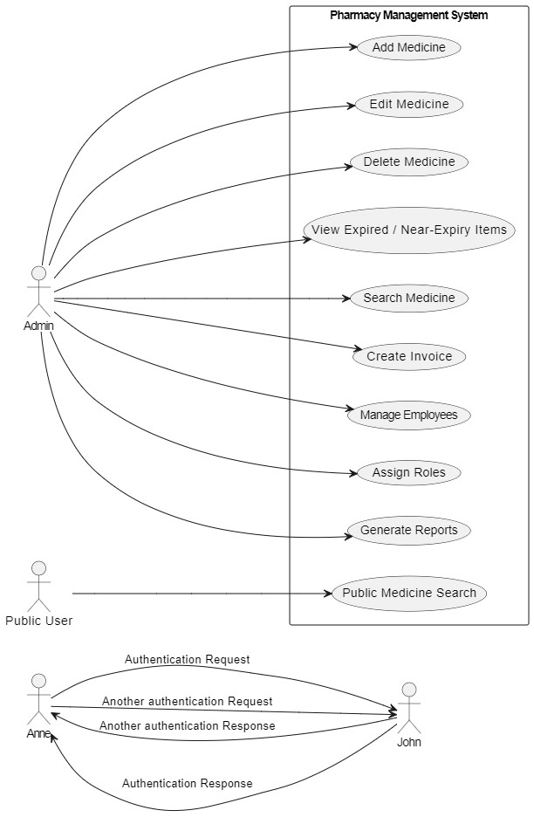
Use Case

Slide 14
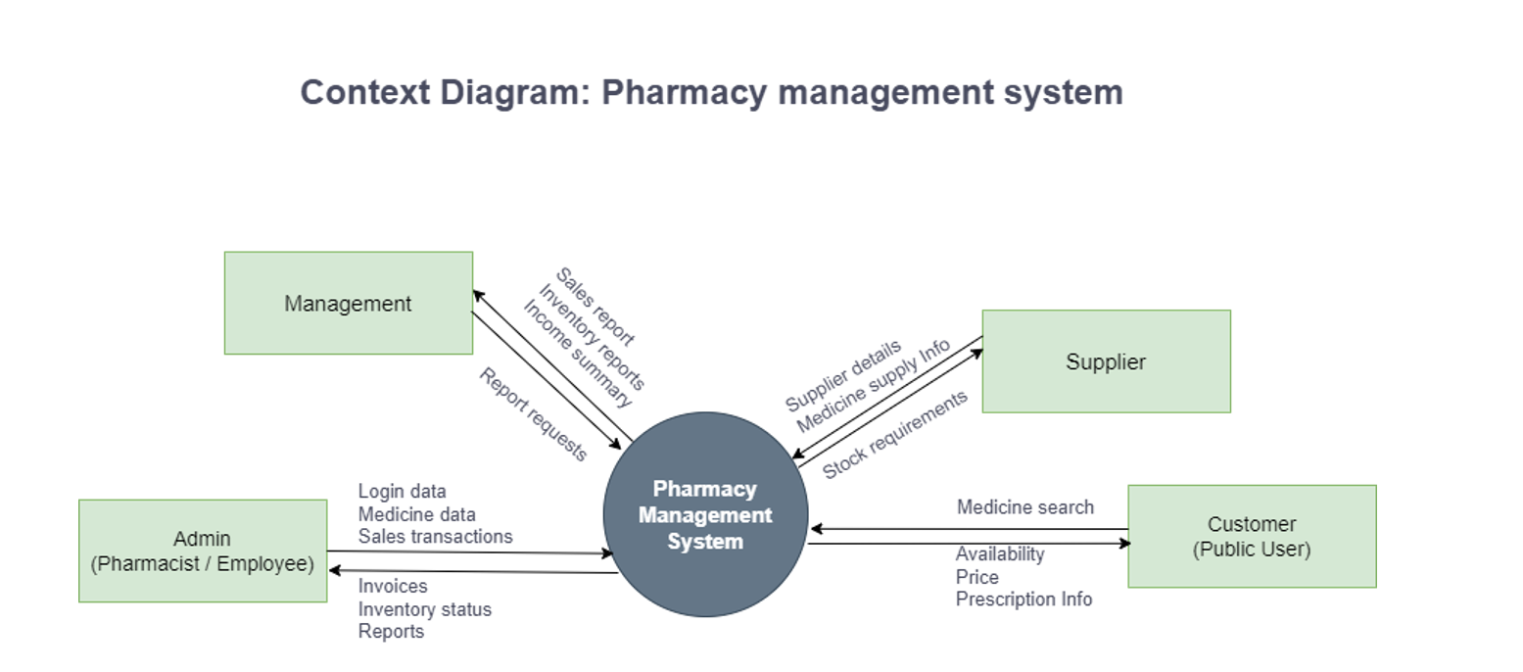

Slide 15
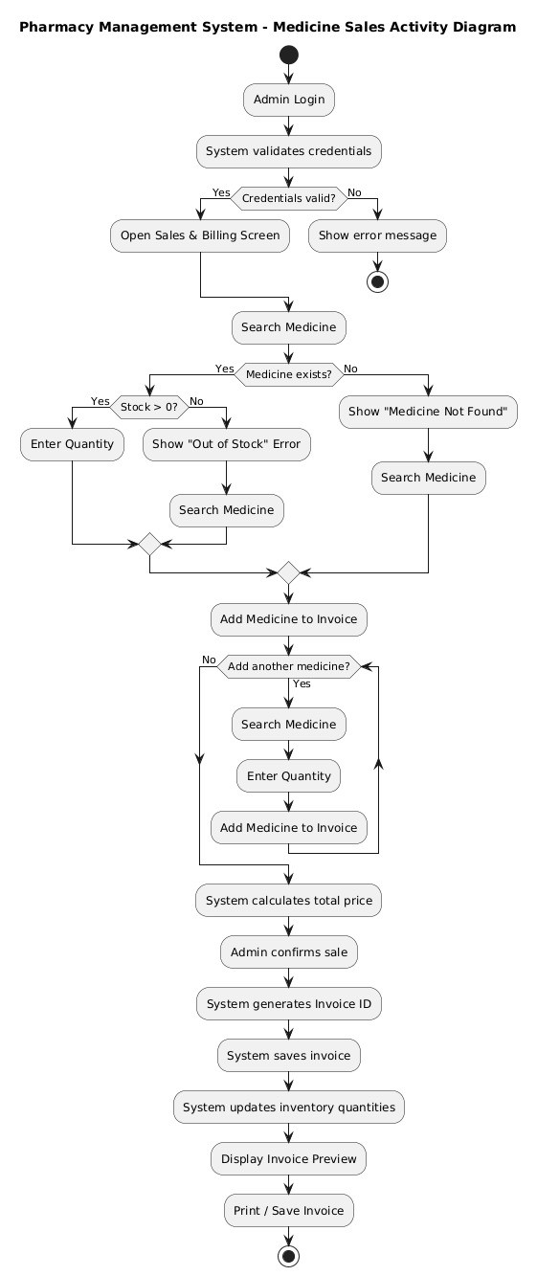

Slide 16
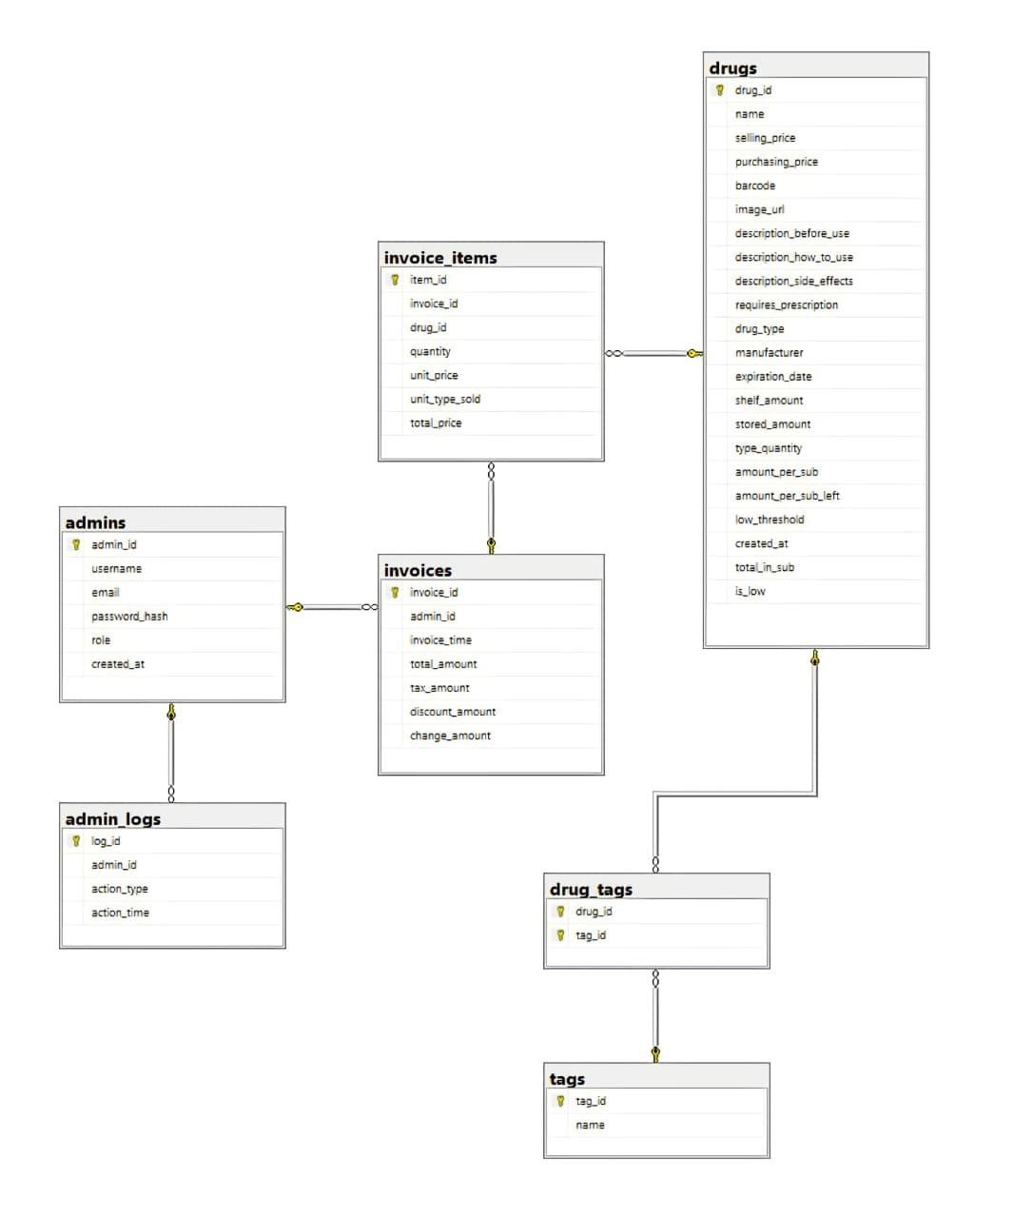
Class Diagram

Slide 17
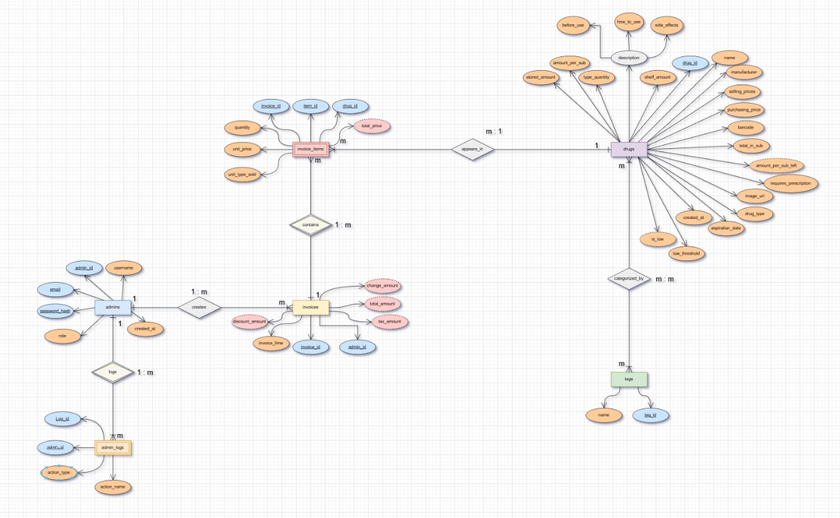
Entity Relationship Diagram (ERD) for the system

Slide 18
3- Implementation: The system was developed in modular components to simplify coding and testing:
Inventory Module: Allows adding, updating, and deleting medicines. Stock levels are automatically updated after each sale.
Sales Module: Records sales, calculates totals, and integrates with the invoice printing feature.
Customer Search Module: Enables customers to search for medicines by name or type without entering personal data.
Reporting Module: Generates daily, weekly, and monthly sales reports for management review.
During implementation, we applied best coding practices:
Modular code to make updates easier
Proper comments and documentation for each function
Input validation to prevent errors or invalid entries

Slide 19
4- Challenges & Solutions: During development, we faced several challenges:
Challenge: Accurate sales tracking and inventory updates. Solution: Implemented SQL queries that automatically update stock quantities immediately after each sale and store complete sales history for reporting.
Challenge: Ensuring the invoice prints correctly with all details. Solution: Developed a dynamic invoice generation module that formats and prints invoices after each recorded sale, including medicine names, quantities, prices, and total amount.
Challenge: Designing an interface that is both easy for staff and customers. Solution: Used a clean layout with clear menus, search functionality for customers, and simple forms for pharmacists.

Slide 20
Project Outcome / Results
Reduces manual work for pharmacists
Ensures accurate tracking of medicine stock
Sales and billing are faster and error-free
Generates detailed reports
Invoices can be printed after sales
Customers can quickly search for medicines without entering personal information.

Slide 21
Screenshots from the Result of the Implementation

Slide 22
Admin Side

Slide 23
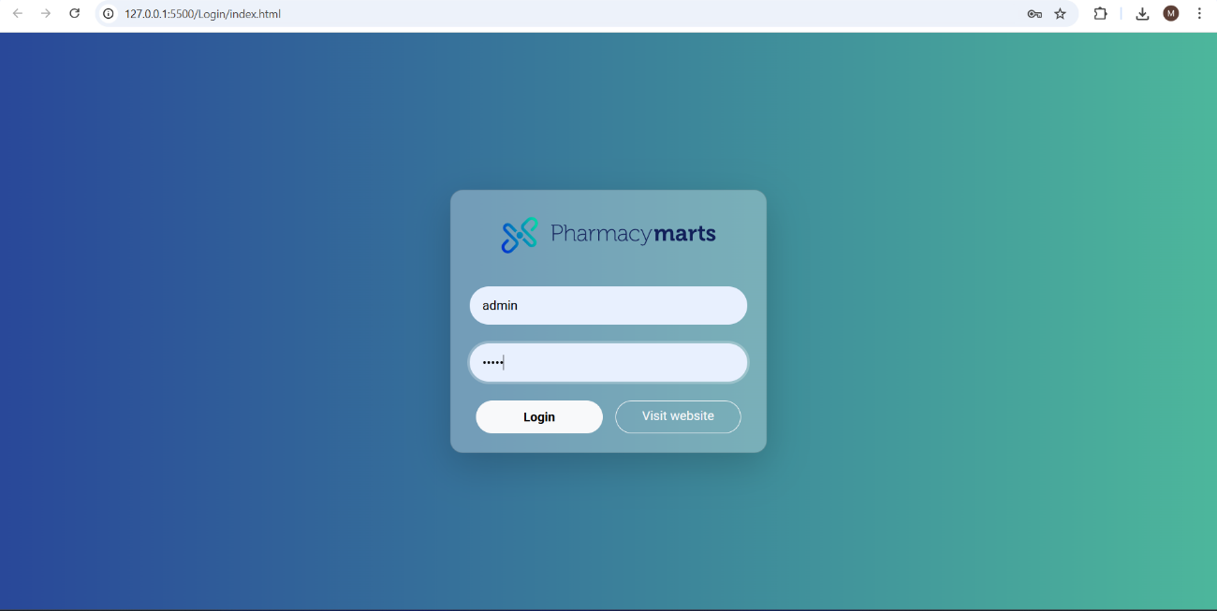

Slide 24
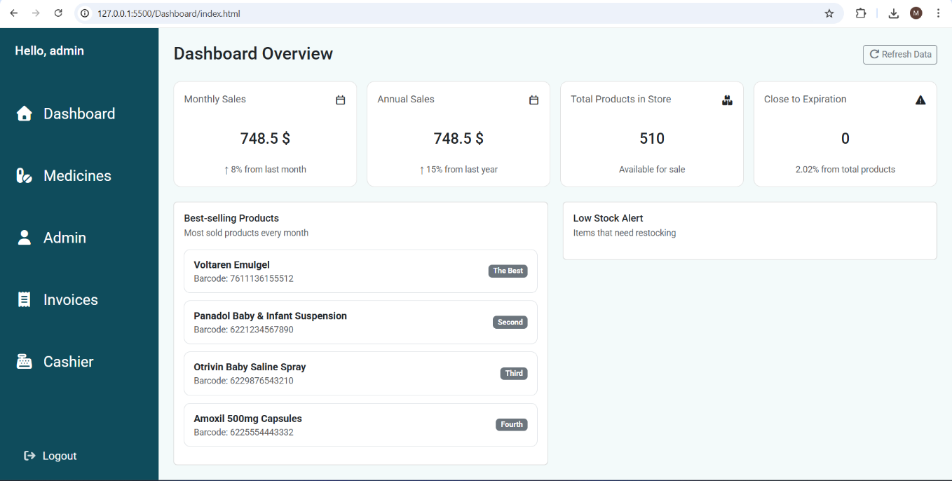

Slide 25
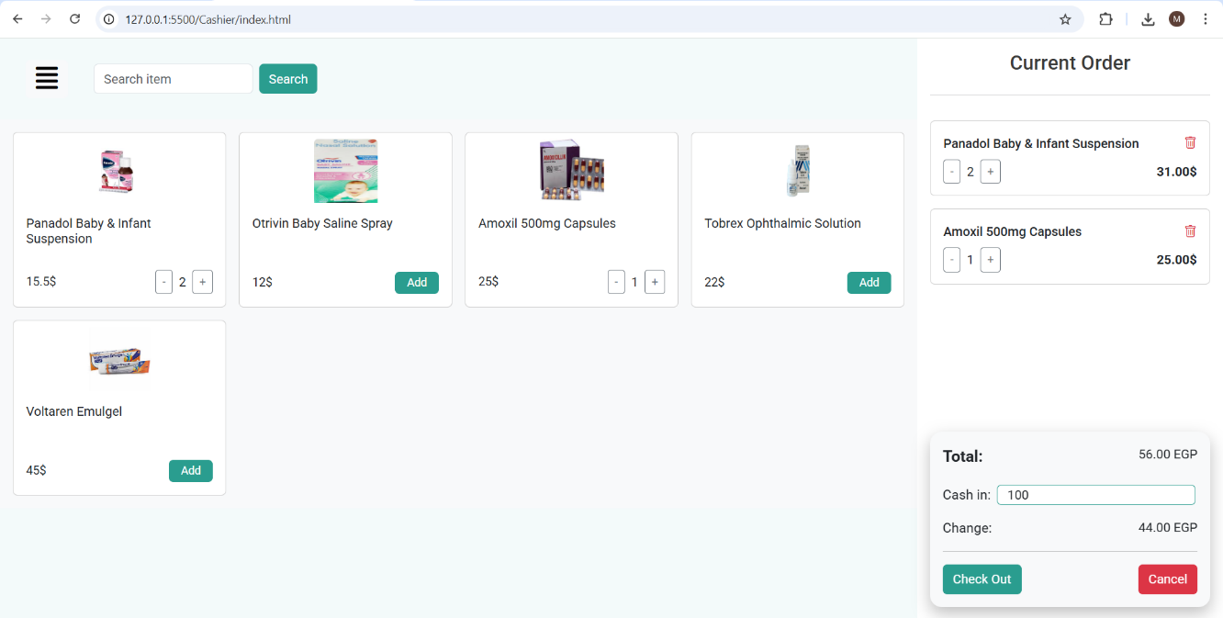

Slide 26
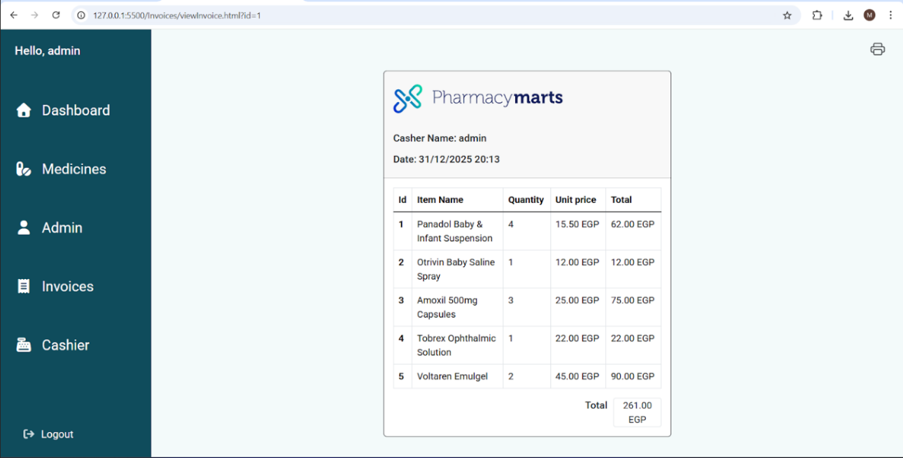

Slide 27
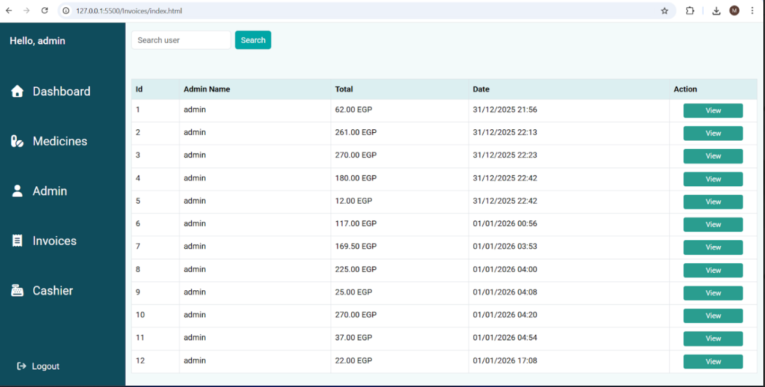

Slide 28
Customer Side

Slide 29
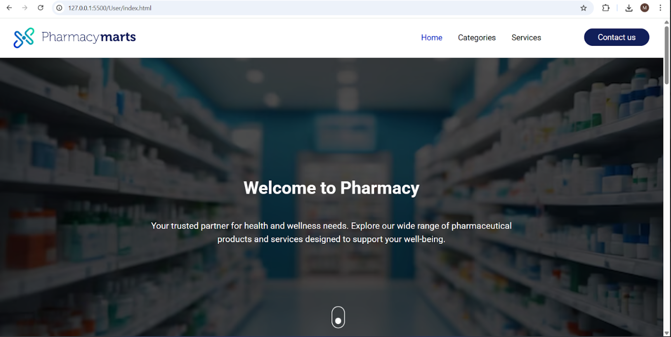

Slide 30
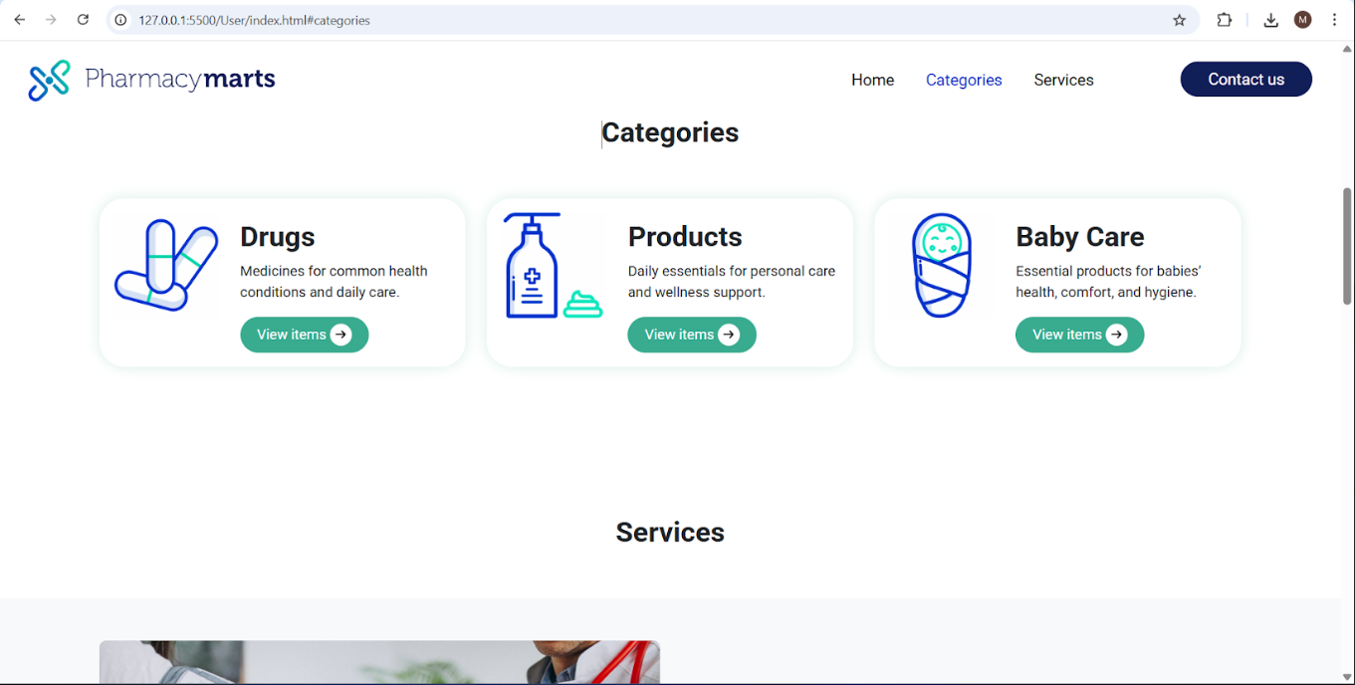

Slide 31
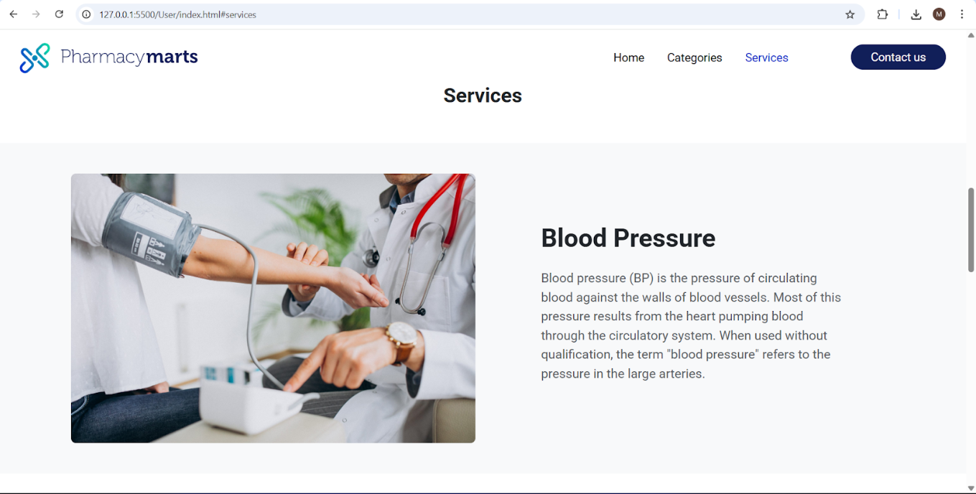

Slide 32
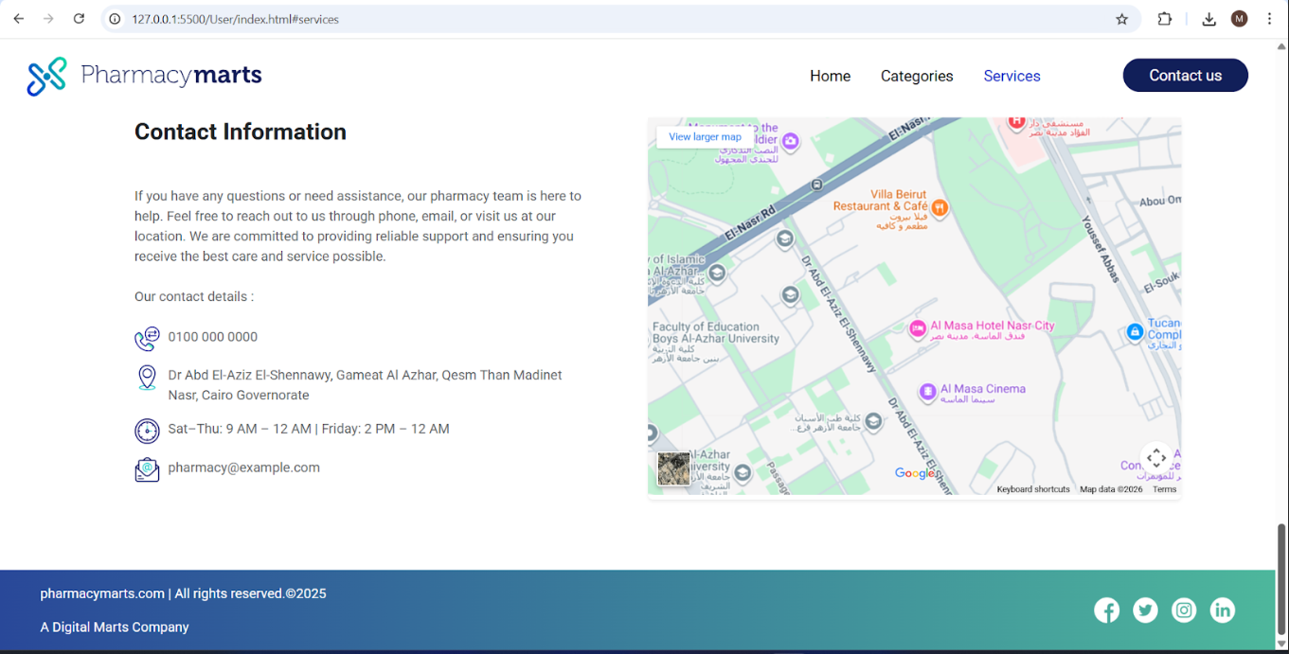

Slide 33
Future Enhancements
Place online orders or reservations
Integrate barcode scanning for medicines
Automated alerts and notifications
User roles and access control improvements
Mobile-friendly interface / Mobile app integration
Integration with accounting systems and make Transactions

Slide 34

The End

